Slide 1

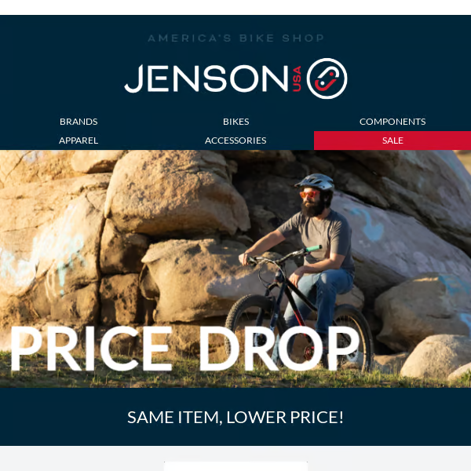
Data Analysis: “From Data to Triumph Insights that Propel You Forward”
By Jatin Limaye

Slide 2
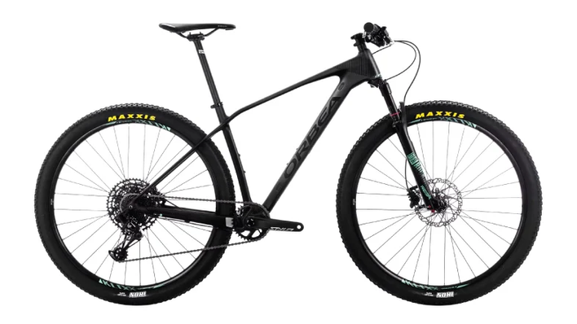
Introduction
Founded in 1958 in Fairfield, New Jersey, Jason USA (originally Jason Industrial) has grown from a small, reliable manufacturer of industrial hoses and power transmission belts into a major player in the industrial sector. From the beginning, Jason USA established itself as a trusted partner to distributors across the country, thanks to its unwavering commitment to quality and customer care.
Diverse Product Offerings:
Today, Jason USA is known for its extensive range of industrial and hydraulic hoses, power transmission belts, couplings, and accessories. The company serves a wide variety of industries, including agriculture, oil and gas, construction, and more. Jason USA's commitment to innovation and customer satisfaction remains the cornerstone of its success as it continues to evolve and adapt to the changing demands of the global marketplace​
Page 02/10

Slide 3
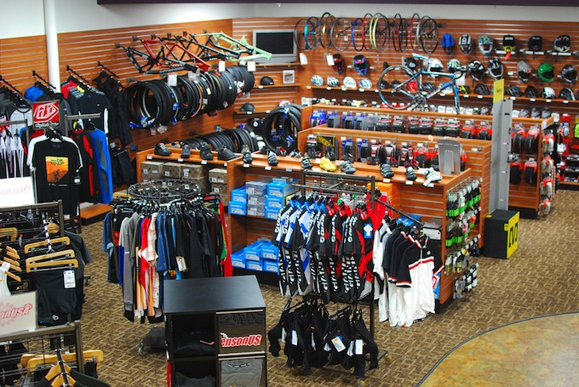
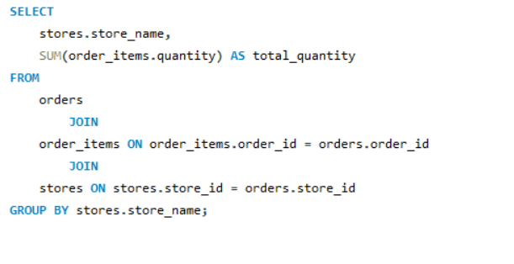
Question 1
Find the total number of products sold by each store along with the store name.

Slide 4

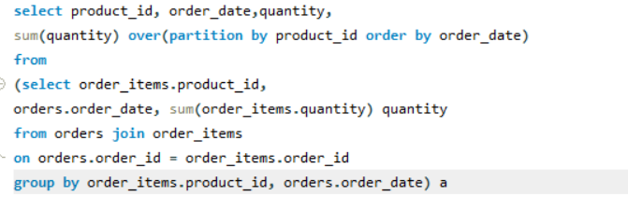
Question 2
Calculate the cumulative sum of quantities sold for each product over time.

Slide 5

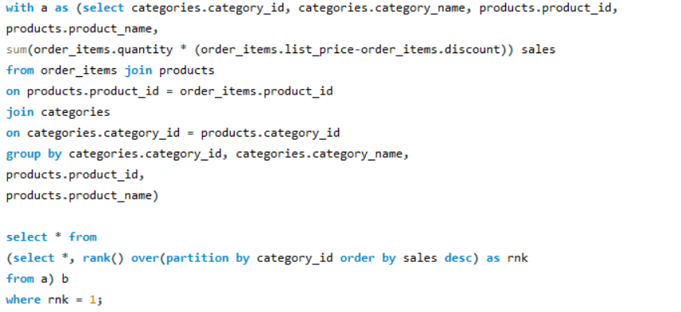
Question 3
Find the product with the highest total sales (quantity * price) for each category.

Slide 6
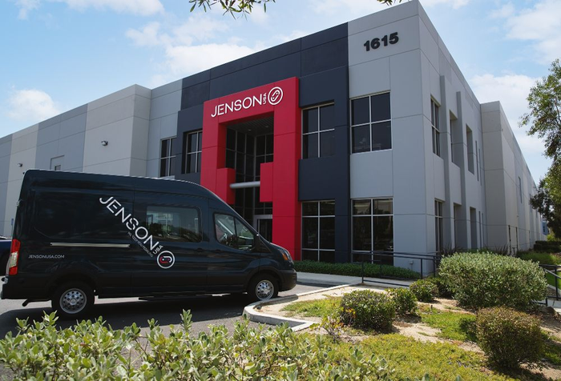
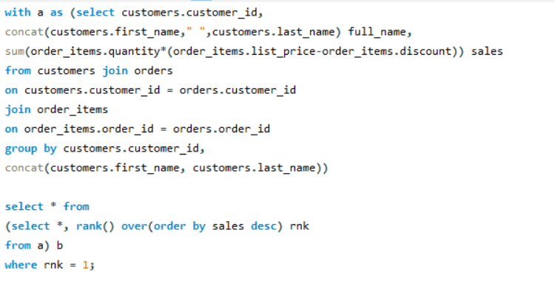
Question 4
Find the customer who spent the most money on orders.

Slide 7
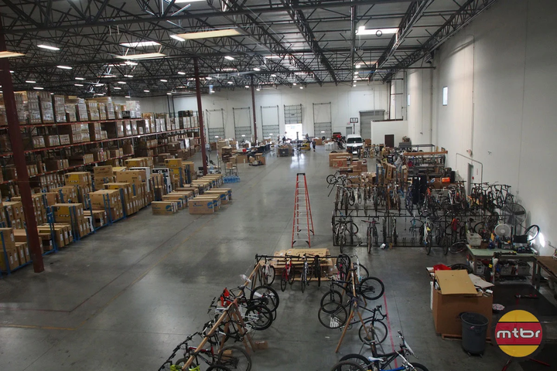
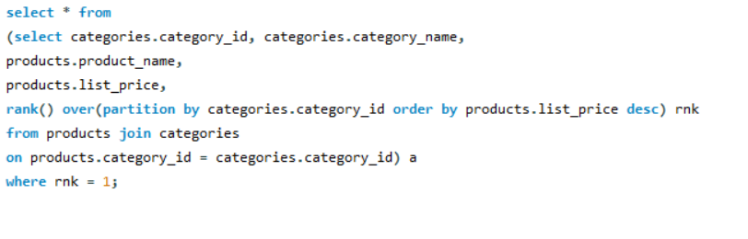
Question 5
Find the highest-priced product for each category name.

Slide 8
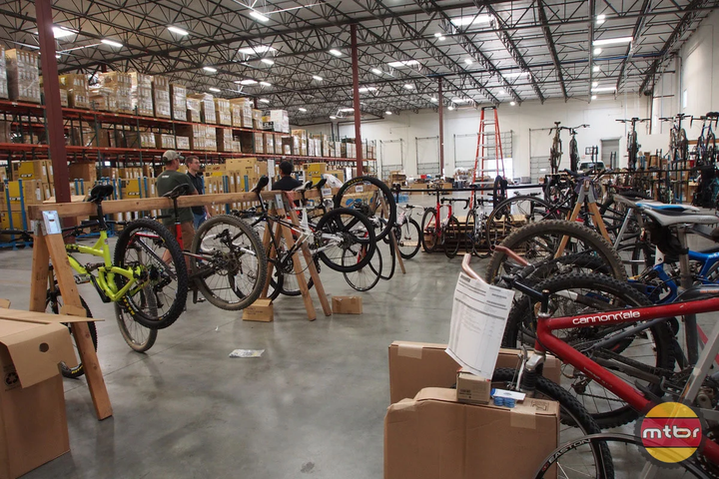
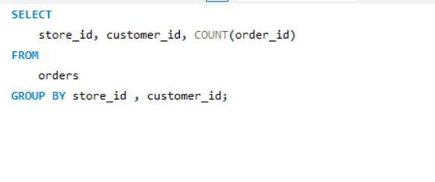
Question 6
Find the total number of orders placed by each customer per store.

Slide 9
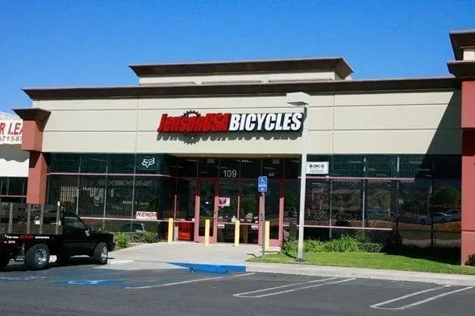
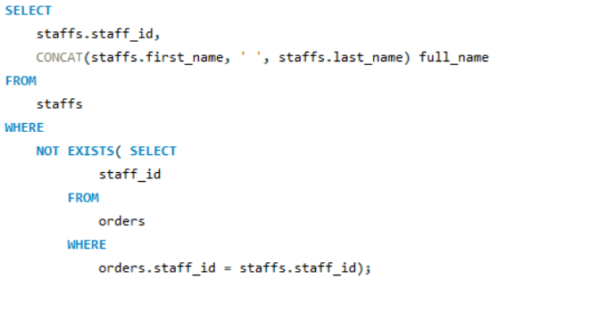
Question 7
Find the names of staff members who have not made any sales.

Slide 10

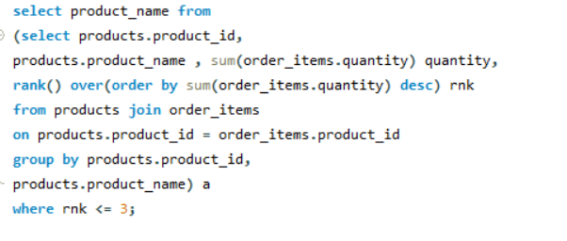
Question 8
Find the top 3 most sold products in terms of quantity.

Slide 11

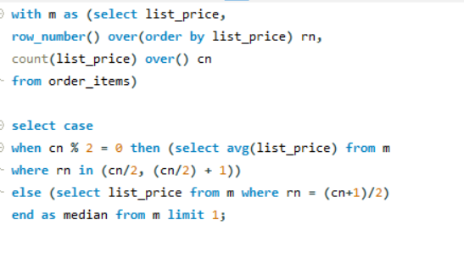
Question 9
Find the median value of the price list.

Slide 12
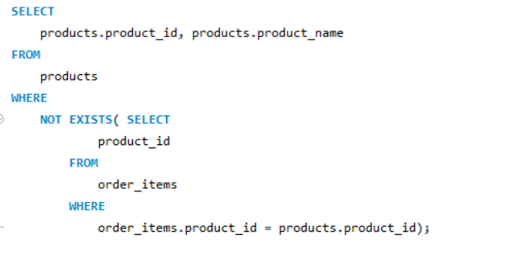
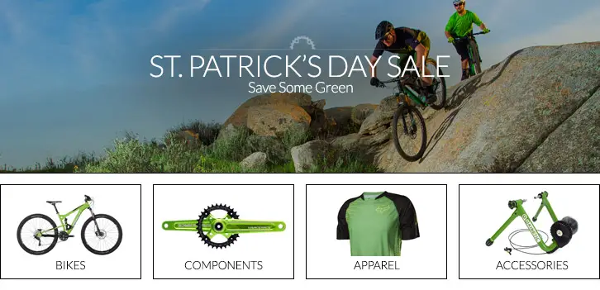
Question 10
List all products that have never been ordered.(use Exists)

Slide 13
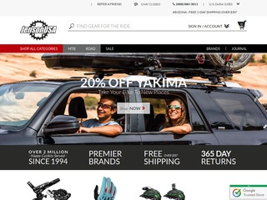
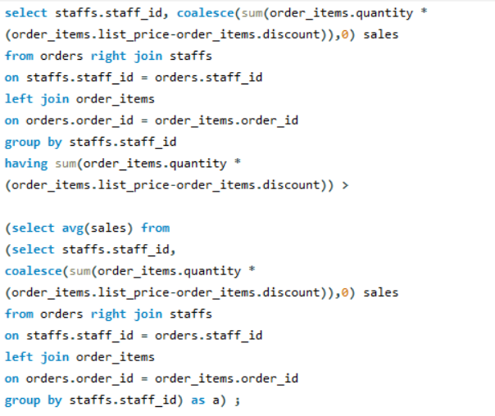
Question 11
List the names of staff members who have made more sales than the average number of sales by all staff members.

Slide 14
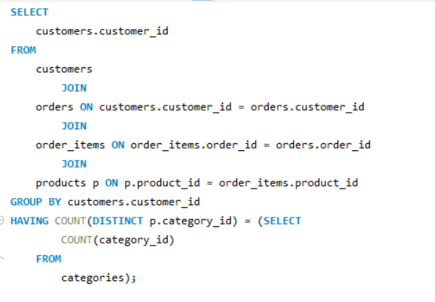
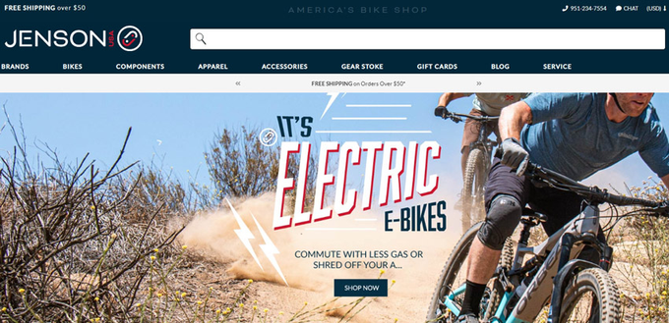
Question 12
Identify the customers who have ordered all types of products (i.e., from every category).

Slide 15

Conclusion
Key Insights;-
Top Performing Stores and Products:
a. Analyze the total number of products sold by each store. Identifying top-performing stores can help optimize marketing efforts for underperforming ones.
b. Insights into the top 3 most sold products reveal customer preferences and can guide inventory management.
Product Performance by Category:

Slide 16
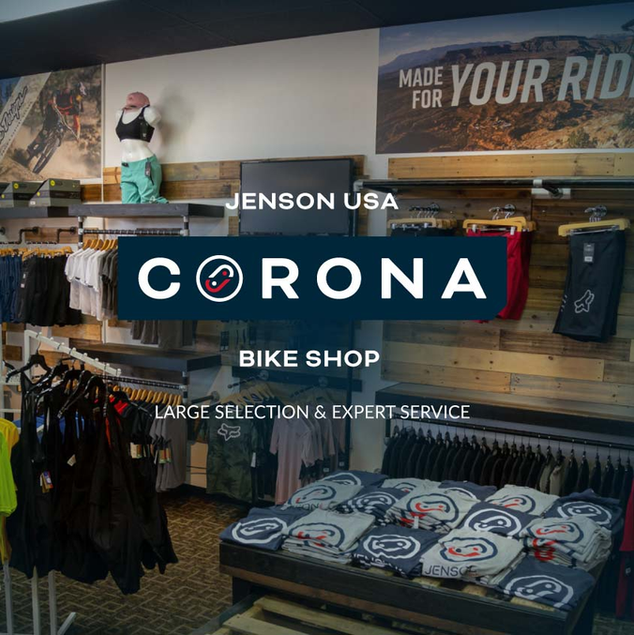
a. By identifying the product with the highest total sales per category, you can tailor product lines based on category performance, helping to align your strategy with consumer demand.
Customer and Sales Trends:
a. Recognizing the customer who spent the most can inform loyalty programs and personalized offers.
b. Determining customers who have ordered from every category suggests a highly engaged customer base and may indicate opportunities for upselling and cross-selling.
Staff Performance and Sales:

Slide 17
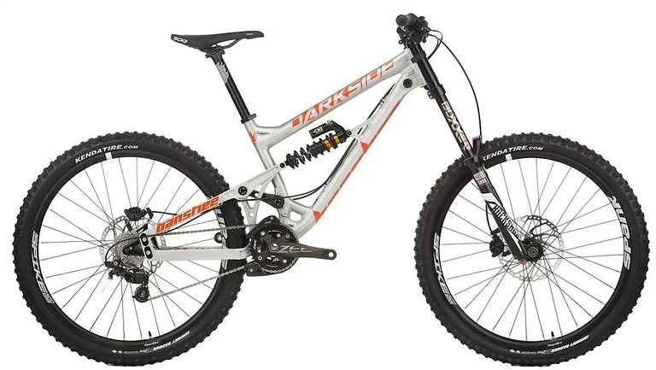
a. Identifying staff members who made more sales than average highlights the potential for best practices to be shared across the team.
b. Recognizing staff who made no sales can indicate training or restructuring needs.
Pricing Strategy:
a. Analyzing the highest-priced product for each category and median price values offers insights into pricing strategy and market positioning.
Unordered Products:
a. Listing products that have never been ordered helps eliminate slow-moving inventory and informs future product launches.

Slide 18

Recommandation:-
Focus on High-Performing Stores:
a. Invest resources in top-performing stores while revisiting the strategy for underperforming locations.
Leverage Best-Selling Products:
a. Enhance marketing efforts around the top 3 most sold products to maximize sales. Consider bundling these with less popular items.
Customer Segmentation:

Slide 19

a. Offer special promotions and loyalty rewards to high-value customers and those who purchase across multiple categories.
Staff Training and Incentives:
a. Provide targeted training for staff members who are underperforming. Implement sales incentives to motivate higher performance across the team.
Optimize Product Offerings:
a. Remove or reconsider marketing strategies for unordered products. Focus more on products that drive the highest revenue and ensure they are adequately stocked.
Refine Pricing Strategies:
a. Review and adjust pricing strategies based on the identified high-priced products and overall median pricing to ensure competitive yet profitable offerings.

Slide 20
Thank you
If you find my content engaging, consider sharing it with those you know.

